Slide 1

Data Profiling Application
Team : TRAFFICCITYWARRIORS
Anoop Velappan
Anoop Thakur
Abhishek Gupta

Slide 2
Technology STACK
Python
Streamlit is for visualization and creating interactive webpages
Bard API is a powerful tool that allows developers to access the capabilities of Google’s large language model. Bard to generate text, translate languages, write different kinds of creative content, and answer questions in an informative way.
Pandas is a powerful and popular Python library used for data manipulation and analysis
PyCharm is a popular integrated development environment (IDE) developed by JetBrains, specifically designed for Python development

Slide 3
Code
from nbformat import write from bardapi import Bard import os import streamlit as st import pandas as pd import numpy as np import ydata_profiling from streamlit_pandas_profiling import st_profile_report from ydata_profiling import ProfileReport from transformers import pipeline print("Hello, PyCharm!") st.title("Data Profiling App") st.subheader("This app will help you to do Data Exploration") st.sidebar.header("User Input Features") uploaded_file = st. sidebar.file_uploader("upload your input Excel file", type=["csv"]) if uploaded_file is not None: st .markdown("----") my_data = pd.read_csv(uploaded_file, index_col=None) st.subheader("Uploaded CSV File- Sample Dataset") st.write(my_data) st.subheader("OpenAI Analysis") os.environ['_BARD_API_KEY'] = "Your Key" api_key = os.environ.get("_BARD_API_KEY") default_multiline_text = """Transaction Amount should always match Reported Amount, except when the transaction involves cross-currency conversions, in which case a permissible deviation of up to 1% is allowed. Account Balance should never be negative, except in cases of overdraft accounts explicitly marked with an "OD" flag. Currency should be a valid ISO 4217 currency code, and the transaction must adhere to cross-border transaction limits as per regulatory guidelines. Country should be an accepted jurisdiction based on bank regulations, and cross-border transactions should include mandatory transaction remarks if the amount exceeds $10,000.Display Row Level Transaction Details""" input_text = st.text_area("Regulatory Reporting Instruction", height=250,value=default_multiline_text) answer = Bard(token=api_key).get_answer(f'{input_text} this data {my_data}')['content'] st.write(f'{answer}') input_text2 = st.text_area("ChatBot - Raise Your Question") answer2 = Bard(token=api_key).get_answer(f'{input_text2} this data {my_data}')['content'] st.write(f'{answer2}') st.subheader("Pandas Review") profile = ProfileReport(my_data, title="Summary of the Data") st_profile_report(profile) else: st. markdown('----') st.write("You did not upload a new file")

Slide 4
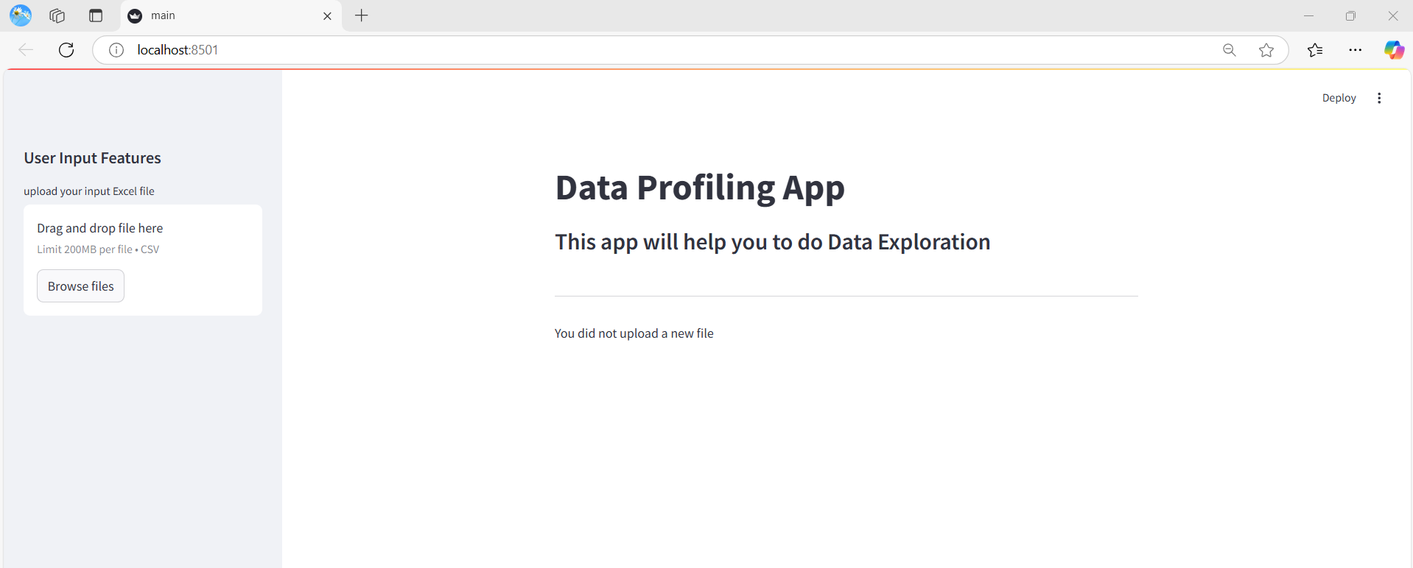
Initial PAGE

Slide 5
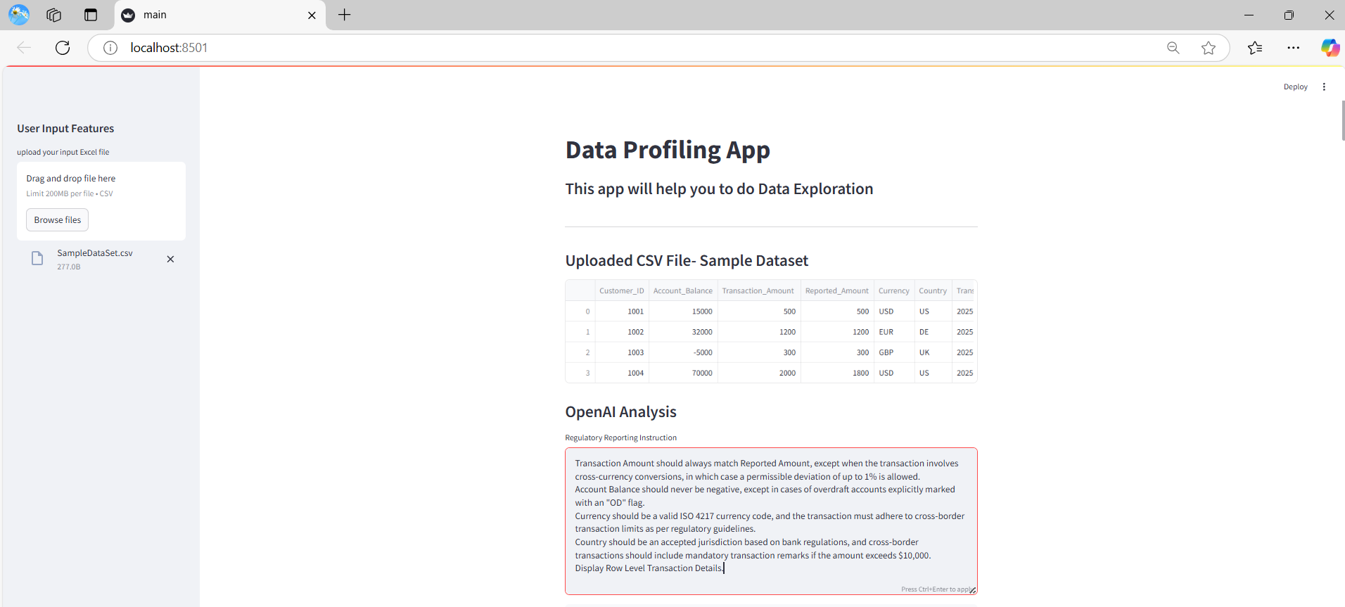
UPLOADED CSV FILE – Default REGULATORY INSTRUCTION

Slide 6
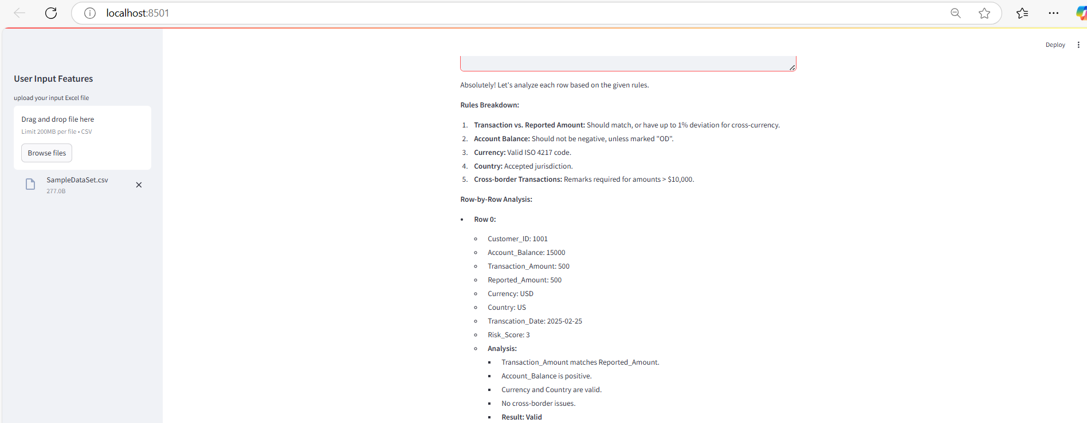
Bard API – Response (Customer 1001)

Slide 7
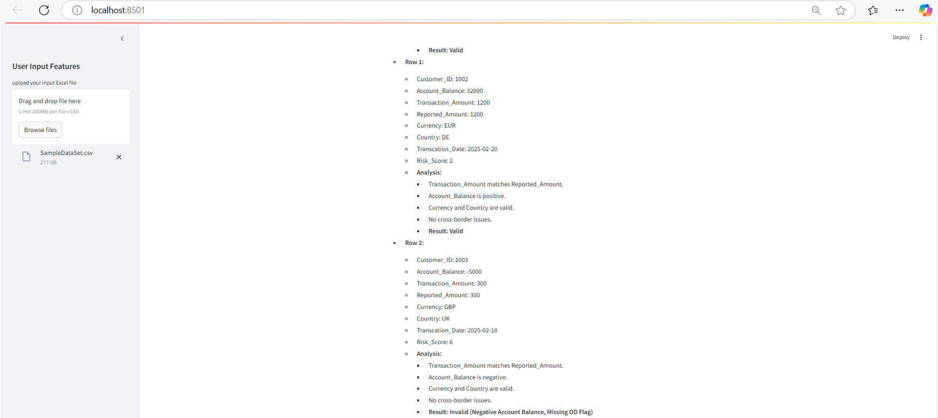
Bard API – Response (Customer 1002 & 1003)

Slide 8
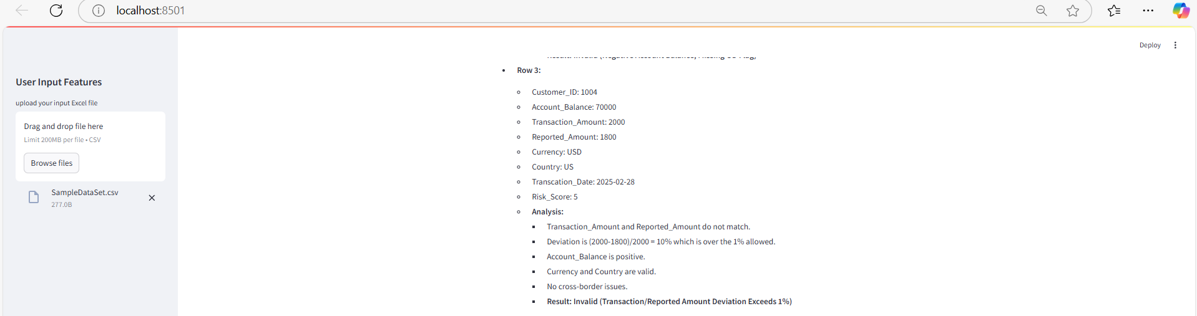
Bard API – Response (Customer 1004)

Slide 9
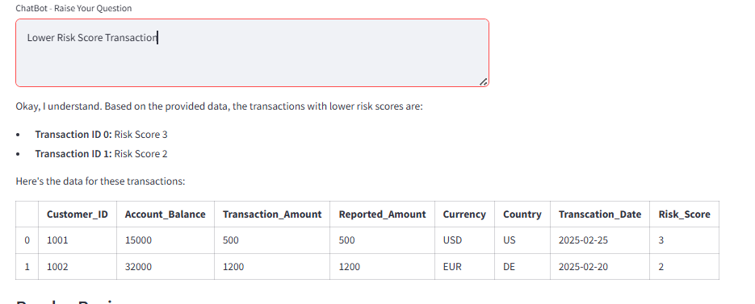
Raise Your QUESTION

Slide 10
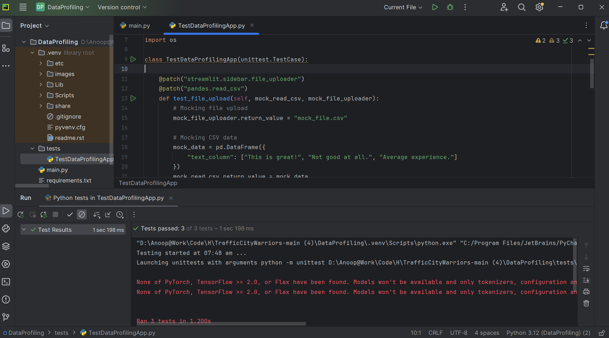
Test Results

Slide 11
Thank You…!

